Slide 1
Corrfunc: Blazing fast correlation functions with SIMD Intrinsics
Dr. Manodeep Sinha
ASTRO 3D Centre of Excellence, Swinburne
Repo: github.com/manodeep/Corrfunc/
Collaborators: Lehman Garrison Contributors: Andrew Hearin, Nick Hand

Slide 2
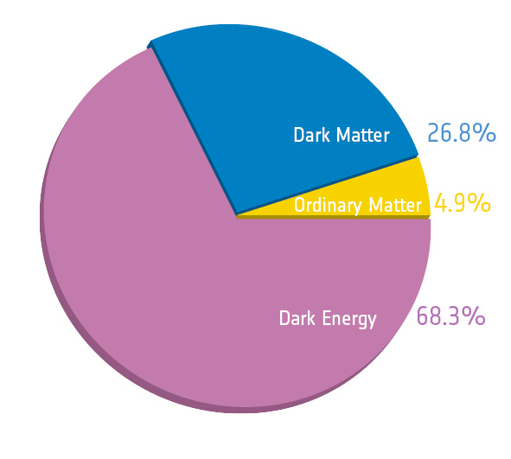
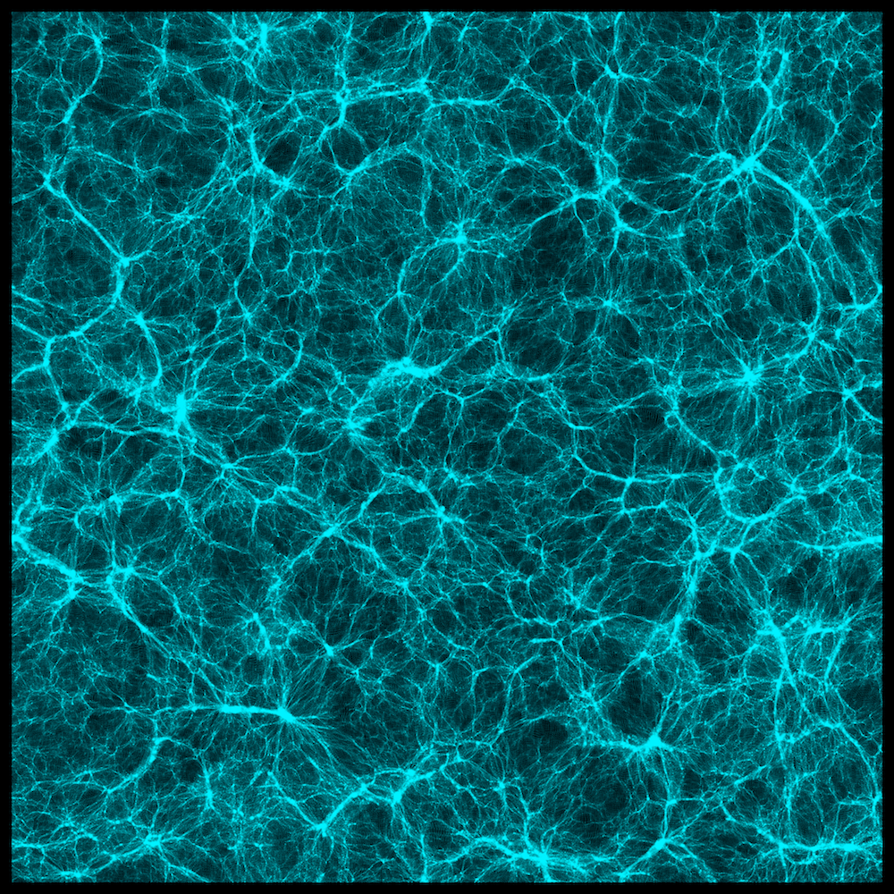

ΛCDM Picture: Galaxies live in Halos
Cosmology
Gravity
Supercomputers
LasDamas Simulations, XSEDE/TACC

Slide 3
ΛCDM Picture: Galaxies live in Halos
Baryon Physics
(messy)
Cosmology
+
Gravity
Supercomputers

Slide 4

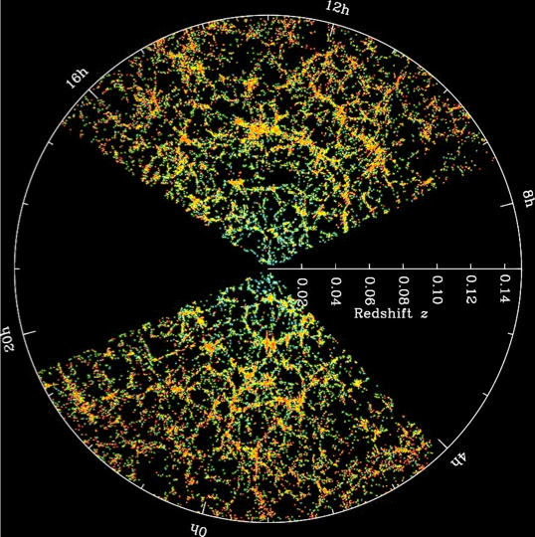
Quantifying the Galaxy Distribution

Slide 5
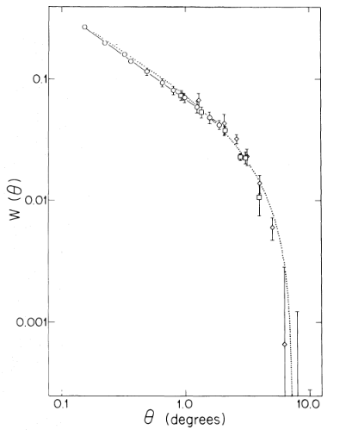
What is a Correlation Function?
Groth & Peebles, 1977
Measures the excess probability of finding a pair at some separation.
Excess Probability
Separation Scale

Slide 6
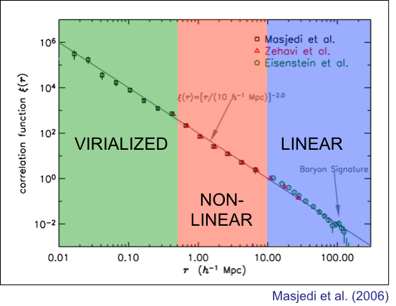
Galaxy Clustering on different scales
Galaxy formation physics
Gravity + Cosmology

Slide 7
Correlation functions are fundamental to understand how galaxies populate halos

Slide 8
Code for a Correlation Function
for(int i=0;i<N1;i++) {
for(int j=0;j<N2;j++) {
double dist = @distance_metric@(point[i], point[j]);
if(dist < mindist || dist >= maxdist) {
continue;
}
int ibin = @dist_to_bin_index@(dist);
numpairs[ibin]++;
}
}

Slide 9
Code for a Correlation Function
for(int i=0;i<N1;i++) {
for(int j=0;j<N2;j++) {
double dist = @distance_metric@(point[i], point[j]);
if(dist < mindist || dist >= maxdist) {
continue;
}
int ibin = @dist_to_bin_index@(dist);
numpairs[ibin]++;
}
}

Slide 10
Simple Code is … simple
Ignores domain knowledge (maxdist << L)
Not optimal for hardware*
Can not be vectorized by compiler
for(int i=0;i<N1;i++) {
for(int j=0;j<N2;j++) {
double dist = @distance_metric@(point[i], point[j]);
if(dist < mindist || dist >= maxdist) {
continue;
}
int ibin = @dist_to_bin_index@(dist);
numpairs[ibin]++;
}
}

Slide 11
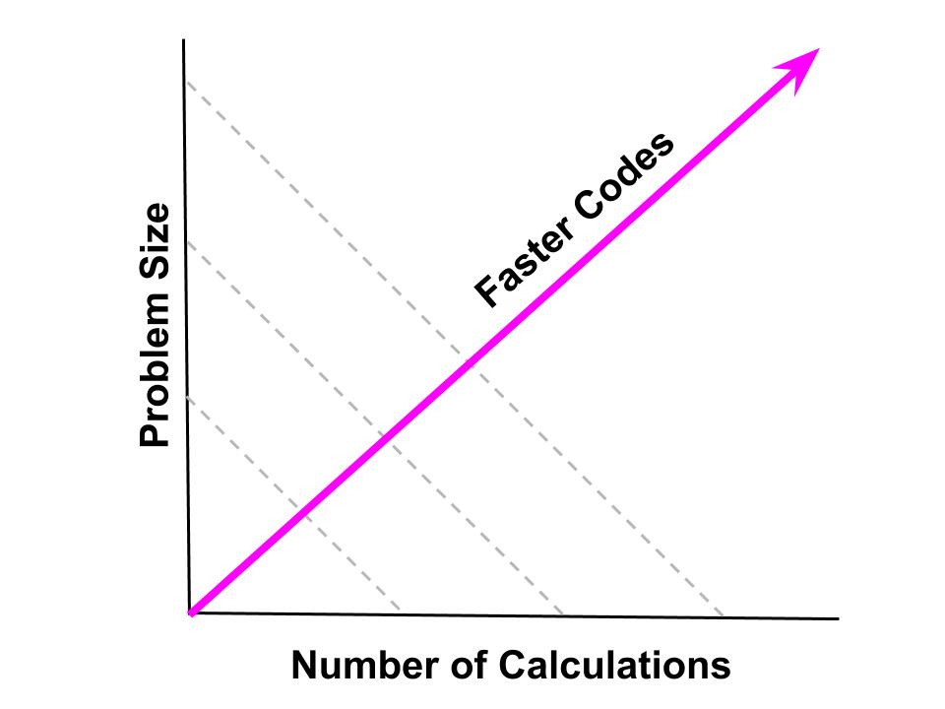
Why Optimise Code?
H/T to Greg Poole
and Jennifer Piscionere

Slide 12
Hardware Detour

Slide 13
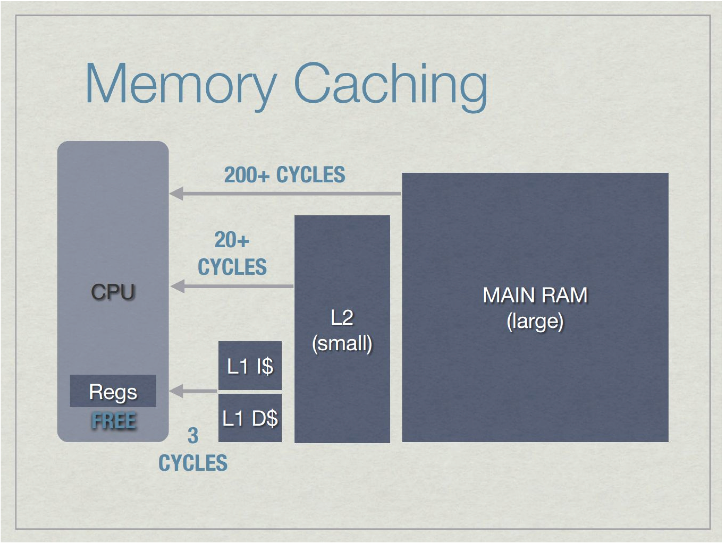
Memory access is slow

Slide 14
Memory access is slow
How fast code runs depends on memory access patterns

Slide 15
Vector Instructions (SIMD)

Slide 16
Timeline of Vector Instructions

Slide 17
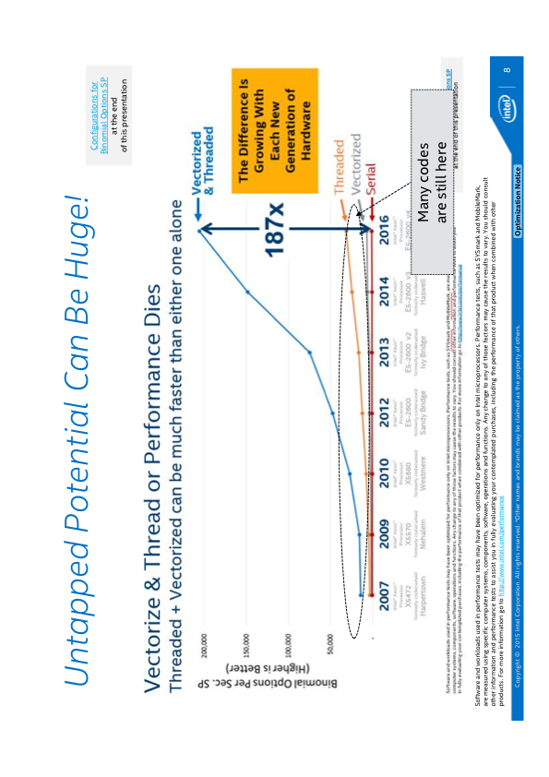
K. O’Leary, Intel

Slide 18
Hardware —> Performance
Power scales as freq^3
Multi-cores at lower clock (instead of one core with a 3GHz clock, 2 cores with 2.1 GHz provides 1.4x op/s @ 70% power)
Memory access is slow
Layers of (smaller, faster, dedicated) -> (larger, slower, shared) caches
Only one instruction per clock cycle
but, clock speeds have stalled
More calculations per clock tick (SIMD/vectorization)
Vectorized operations with efficient memory access within independent kernels

Slide 19
Back to Corrfunc

Slide 20
Simple Code is … simple
Ignores domain knowledge (maxdist << L)
Not optimal for hardware*
Can not be vectorized by compiler
for(int i=0;i<N1;i++) {
for(int j=0;j<N2;j++) {
double dist = @distance_metric@(point[i], point[j]);
if(dist < mindist || dist >= maxdist) {
continue;
}
int ibin = @dist_to_bin_index@(dist);
numpairs[ibin]++;
}
}

Slide 21
How Corrfunc works
Grids the particle distribution into 3D cells of size ~Rmax
Stores particles contiguously within each cell
Sorts particles within a cell in z
Only associates pairs of cells that may contain pairs
Uses vectorised kernels on cell-pairs
Outer OpenMP loop over cell-pairs

Slide 22
Why Corrfunc is FAST
Grids extent with cells of Rmax (domain knowledge)
Stores particles contiguously within each cell (memory access)
Uses sorting to prune (algorithmic complexity)
Uses vector intrinsics (vectorization)
Uses OpenMP (multi-core)

Slide 23
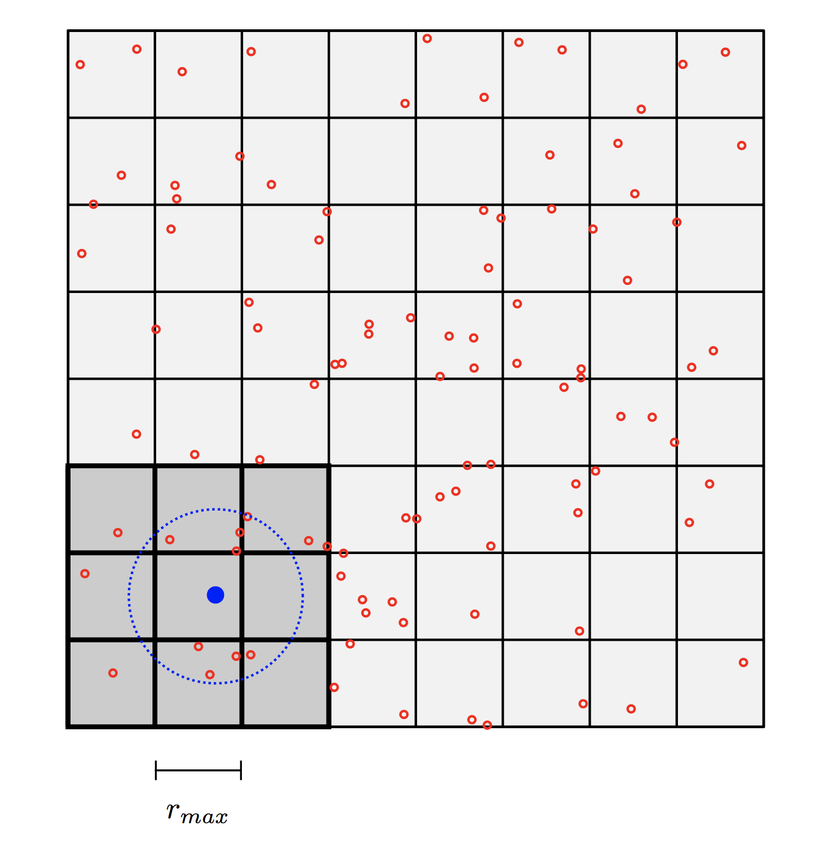
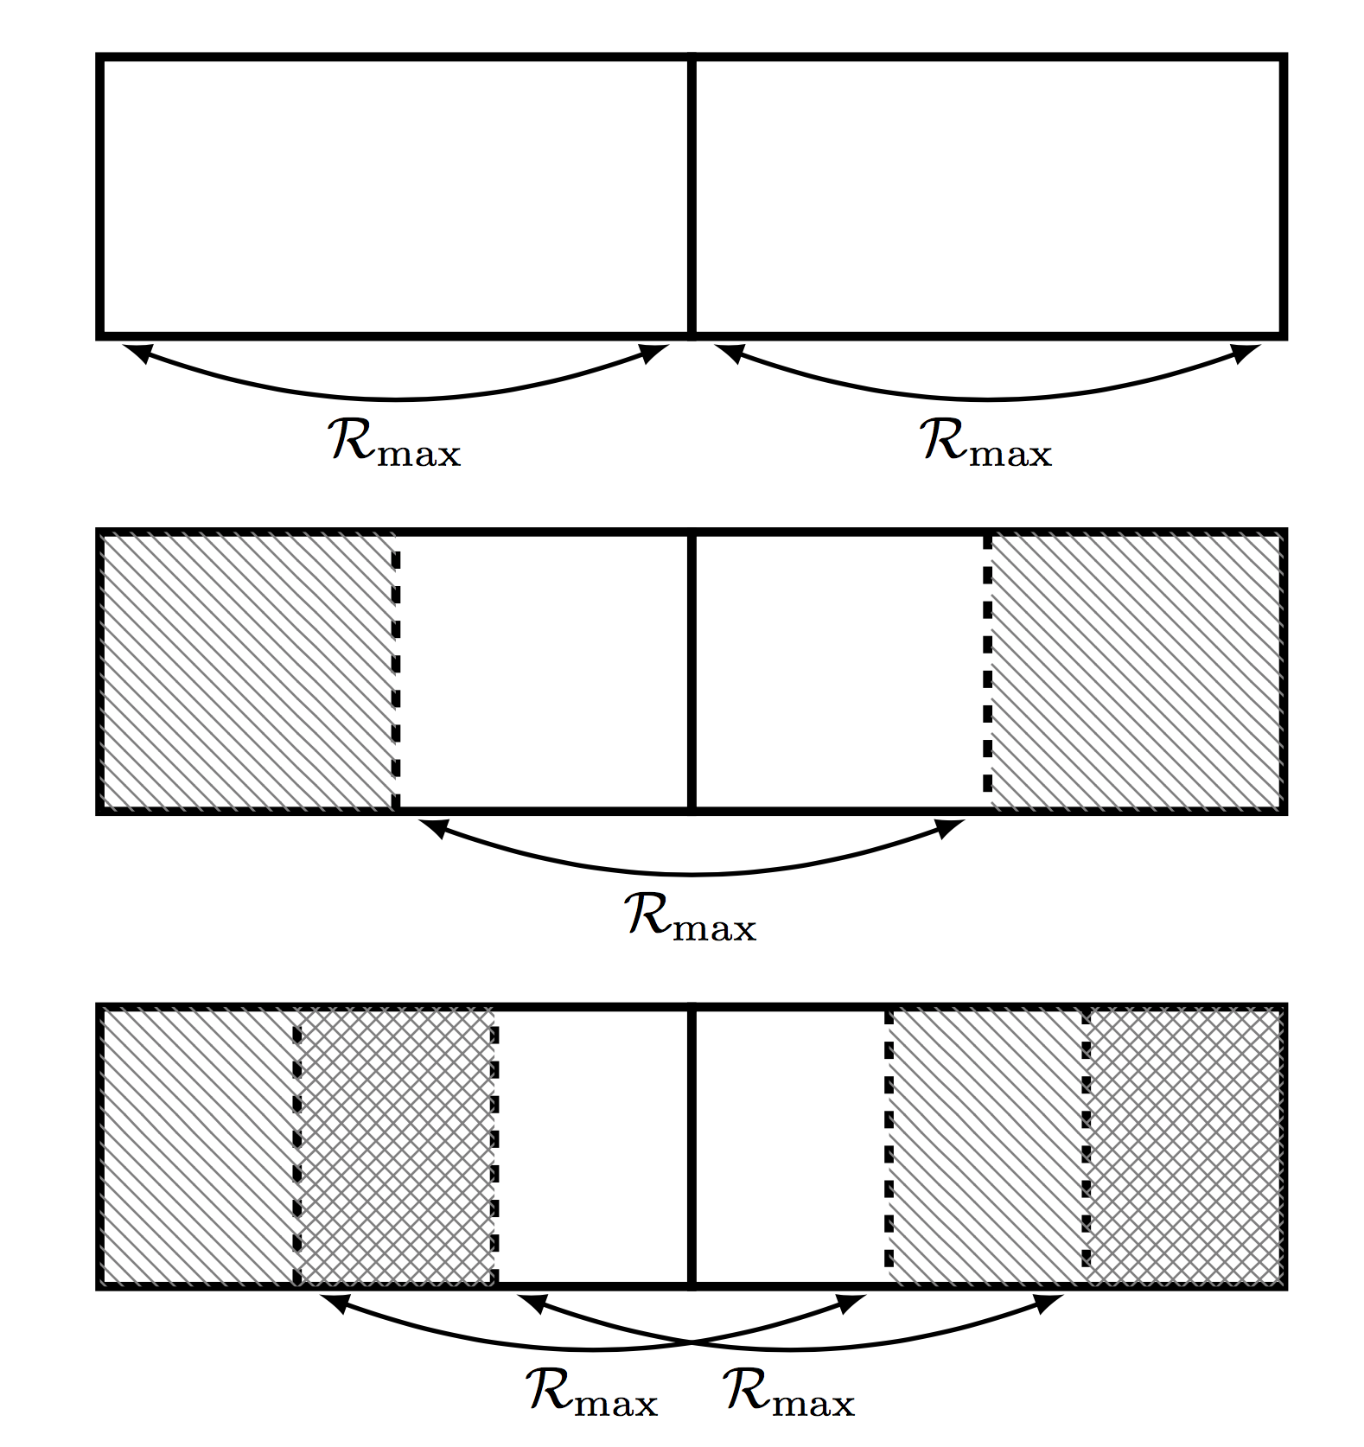
Why Corrfunc is FAST: 3D Grid

Slide 24
Why Corrfunc is FAST: Sorting
Rmax
Sorted in the z-direction

Slide 25
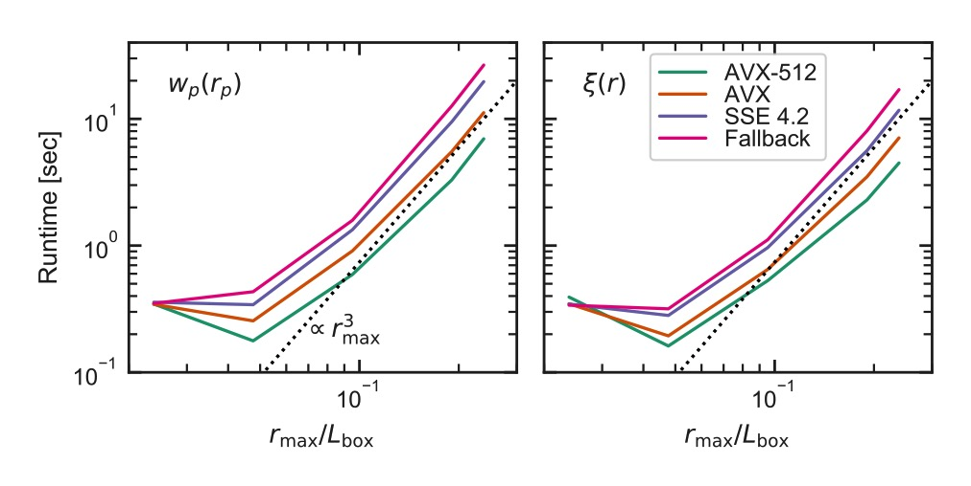
Performance of SIMD Kernels

Slide 26
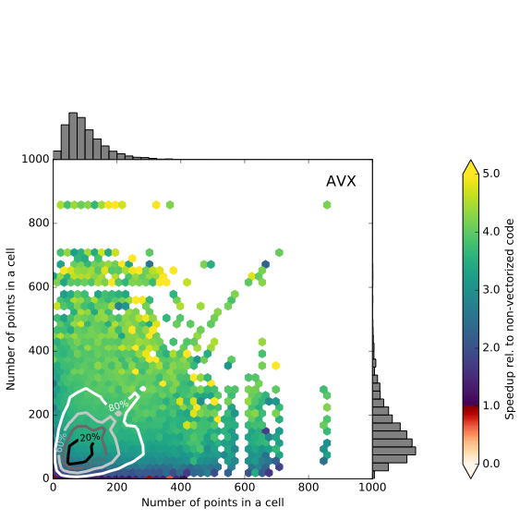
Speedup from Vectorization (AVX)
Vectorization gains for code from the same developer

Slide 27
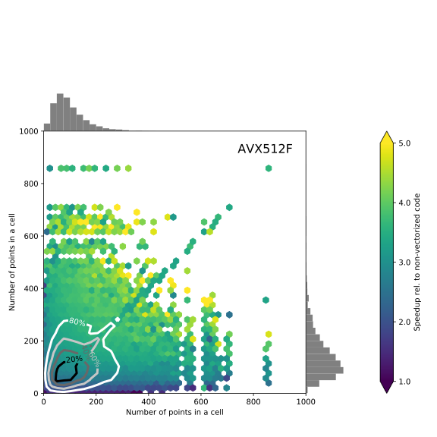
Speedup from Vectorization (AVX512)

Slide 28
Corrfunc Performance: Single-core
on github: paper/scripts/generate_code_comparison.py

Slide 29
Corrfunc Performance: Multi-core
on github: paper/scripts/generate_code_comparison.py

Slide 30
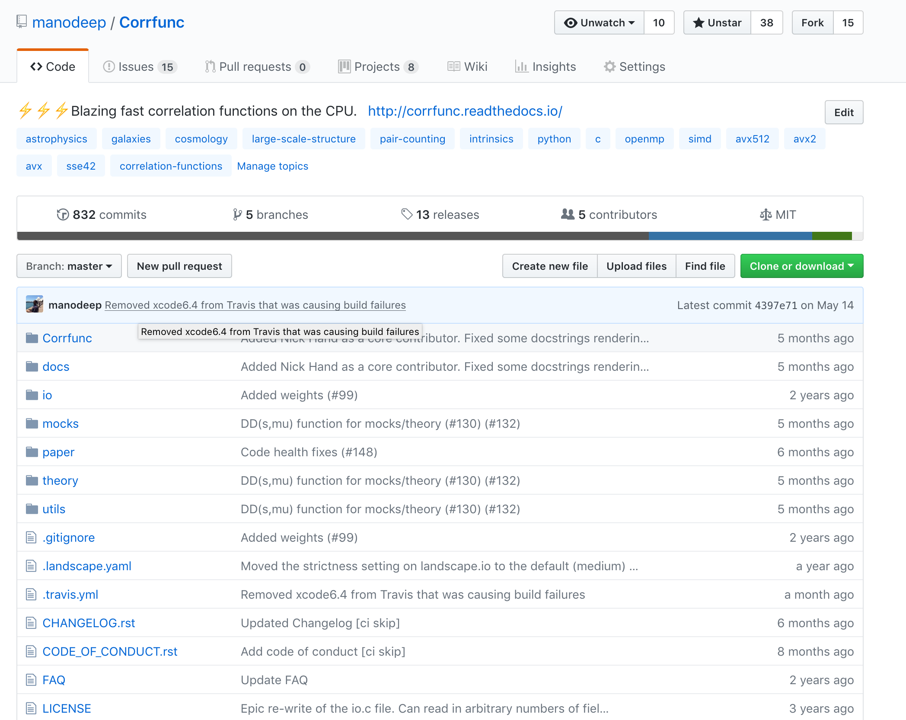
Framework: PVD calculation reduced from 600+ hours to ~1 min
Framework: PVD calculation reduced from 600+ hours to ~1 min

Slide 31
My proudest moments with Corrfunc
Found two compiler bugs, one in Intel icc and one in gcc6.4.0
AVX512 kernels can not be tested because there is no valgrind support
Lead Intel HPC engg. starr’ed Corrfunc
Proud/scared that Corrfunc is now the reference for pair-counting

Slide 32
Why I wrote open-sourced Corrfunc
Inherited codes took ~5 mins. MCMC would have exceeded the funding duration.
fast private version for my specific use-case
Created custom code for experts with 6000x speedup (took < 24 hrs to create)
Demonstrated the need for a fast, flexible, open-source package
That initial 5 min calc. now takes ~5 secs with Corrfunc

Slide 33
Writing Portable and Fast Software is Difficult
Python removes the portability issue
but not fast
Compiled extensions use very basic compiler options (defaults options are the ones used for compiling python)
Compile with the highest compiler-supported ISA
Check ISA at runtime
Usability/Sustainability trumps everything

Slide 34

Conclusions
Corrfunc is optimised using domain knowledge, good memory access pattern, vectorization and OpenMP
Corrfunc is “blazing fast” and
modular, user-friendly, documented, tested, OpenMP parallel, flexible API access, …
GPU version coming - thanks to
my highest cited bib-entry for last year (ascl.net/1703.003)

Slide 35
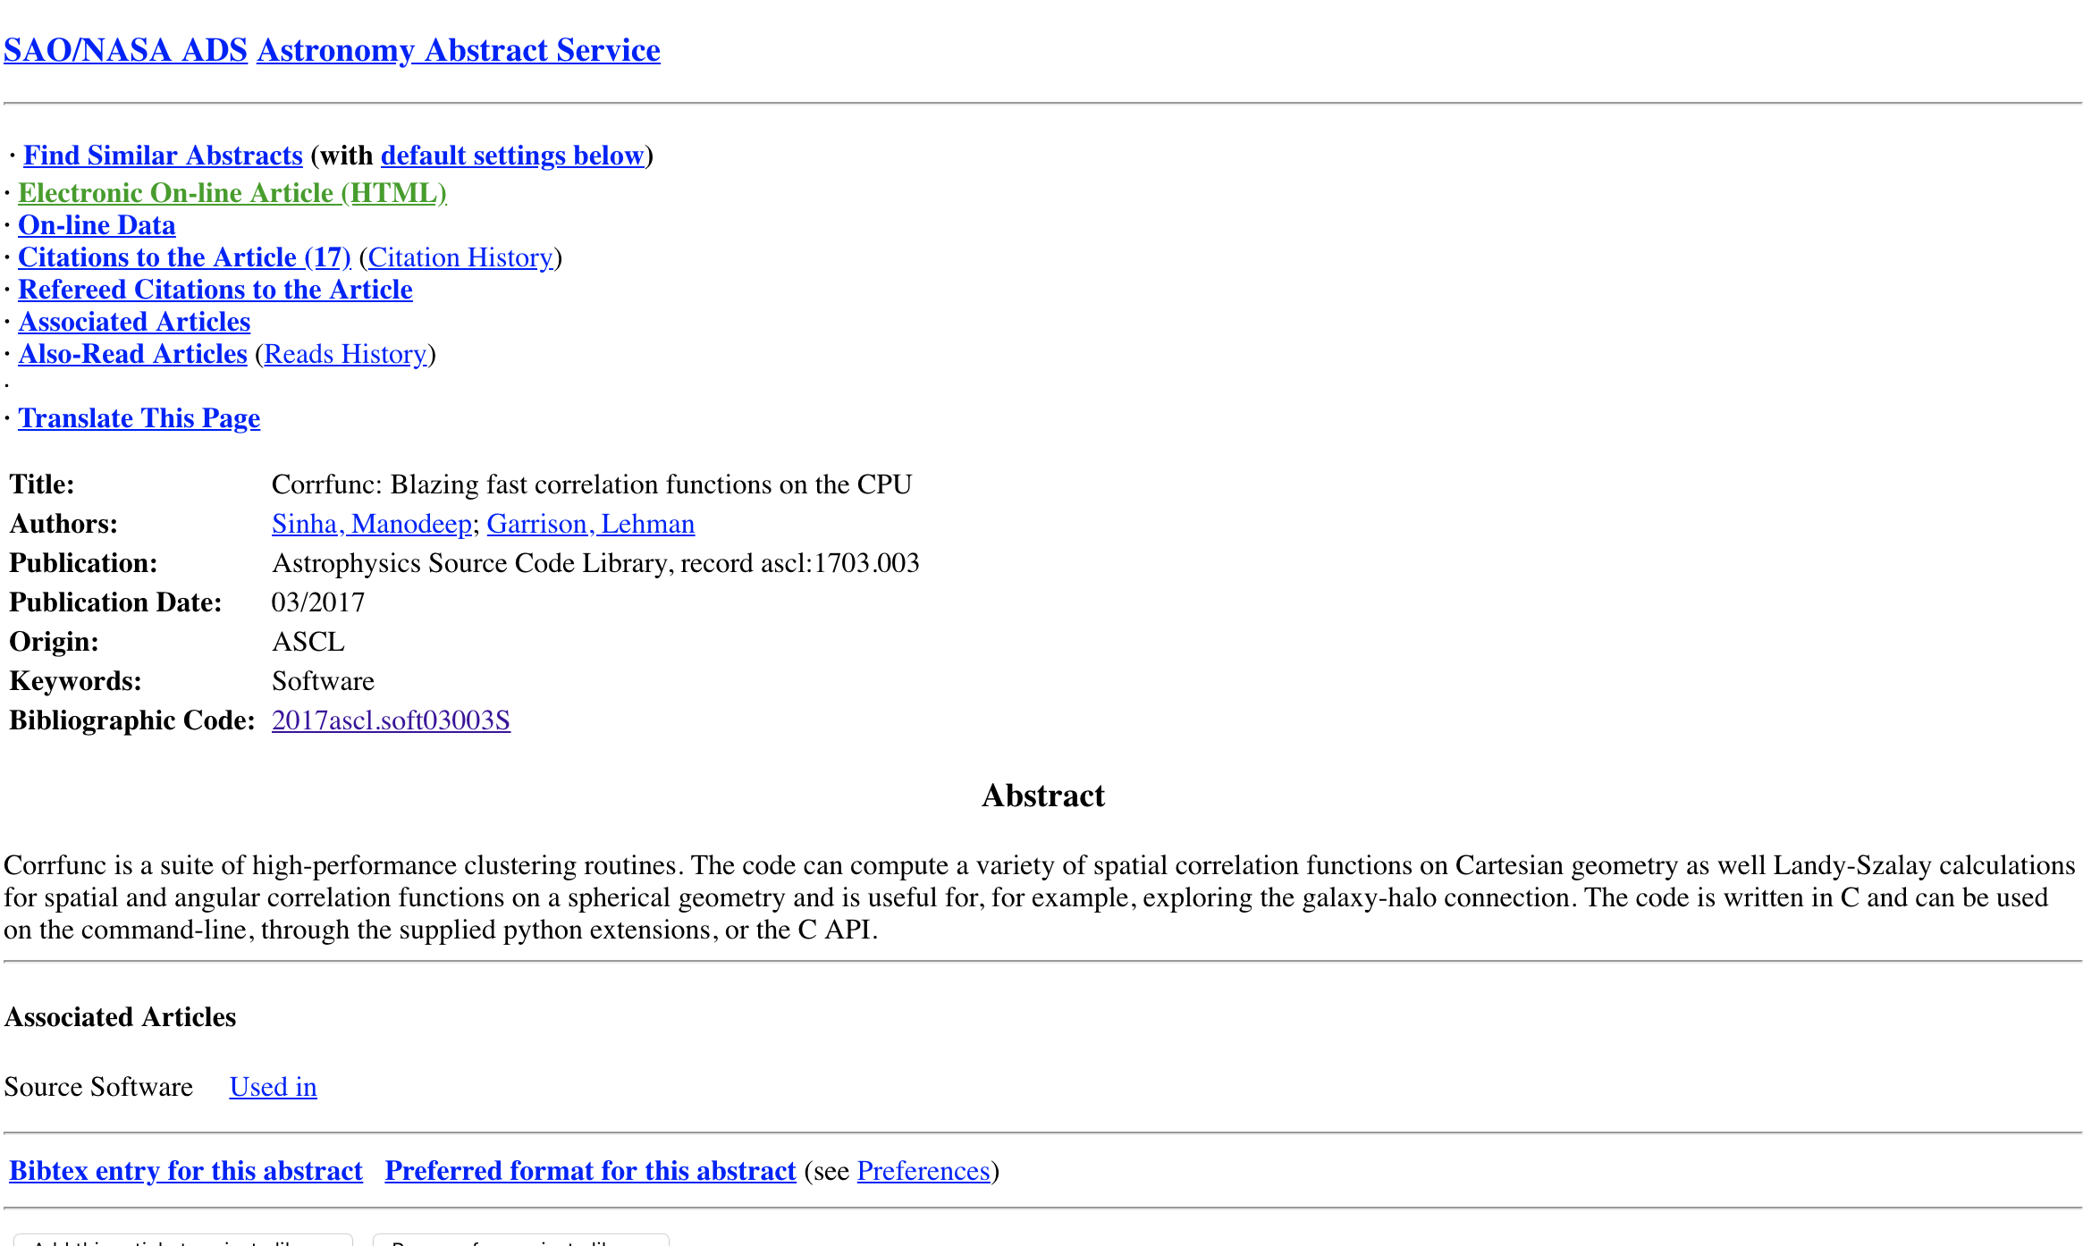


Slide 36
Conclusions
Corrfunc is optimised using domain knowledge, good memory access pattern, vectorization and OpenMP
Corrfunc is “blazing fast” and
modular, user-friendly, documented, tested, OpenMP parallel, flexible API access, …
GPU version coming - thanks to
my highest cited bib-entry for last year (ascl.net/1703.003)

Slide 37
for(int64_t i=0;i<N0;i++) {
const AVX512_FLOATS m_xpos = AVX512_SET_FLOAT(*x0++);
const AVX512_FLOATS m_ypos = AVX512_SET_FLOAT(*y0++);
const AVX512_FLOATS m_zpos = AVX512_SET_FLOAT(*z0++);
DOUBLE *localx1 = x1, *localy1 = y1, *localz1 = z1;
for(int64_t j=0;j<N1;j++) {
AVX512_MASK m_mask_left = (N1 - j) >= AVX512_NVEC ? ~0:masks_per_misalignment_value_DOUBLE[N1-j];
const AVX512_FLOATS m_x1 = AVX512_MASKZ_LOAD_FLOATS_UNALIGNED(m_mask_left, localx1);
const AVX512_FLOATS m_y1 = AVX512_MASKZ_LOAD_FLOATS_UNALIGNED(m_mask_left, localy1);
const AVX512_FLOATS m_z1 = AVX512_MASKZ_LOAD_FLOATS_UNALIGNED(m_mask_left, localz1);
/* this might actually exceed the allocated range but we will never dereference that */
localx1 += AVX512_NVEC;
localy1 += AVX512_NVEC;
localz1 += AVX512_NVEC;
const AVX512_FLOATS m_xdiff = AVX512_SUBTRACT_FLOATS(m_x1, m_xpos); /* (x[j:j+NVEC-1] - x0) */
const AVX512_FLOATS m_ydiff = AVX512_SUBTRACT_FLOATS(m_y1, m_ypos); /* (y[j:j+NVEC-1] - y0) */
const AVX512_FLOATS m_zdiff = AVX512_SUBTRACT_FLOATS(m_z1, m_zpos); /* z2[j:j+NVEC-1] - z1 */
const AVX512_FLOATS m_sqr_xdiff = AVX512_SQUARE_FLOAT(m_xdiff); /* (x0 - x[j])^2 */
const AVX512_FLOATS x2py2 = AVX512_FMA_ADD_FLOATS(m_ydiff, m_ydiff, m_sqr_xdiff);/* dy*dy + dx^2*/
const AVX512_FLOATS r2 = AVX512_FMA_ADD_FLOATS(m_zdiff, m_zdiff, x2py2);/* dz*dz + (dy^2 + dx^2)*/
const AVX512_MASK m_rpmax_mask = AVX512_MASK_COMPARE_FLOATS(m_mask_pimax, r2, m_sqr_rpmax, _CMP_LT_OQ);
/* Create a combined mask */
/* This gives us the mask for all sqr_rpmin <= r2 < sqr_rpmax */
m_mask_left = AVX512_MASK_COMPARE_FLOATS(m_rpmax_mask, r2, m_sqr_rpmin, _CMP_GE_OQ);
if(m_mask_left == 0) {
continue;
}
/* Loop backwards through nbins. m_mask_left contains all the points that */
/* are less than rpmax at the beginning of the loop. */
for(int kbin=nbin-1;kbin>=1;kbin--) {
const AVX512_MASK m_bin_mask = AVX512_MASK_COMPARE_FLOATS(m_mask_left, r2,m_rupp_sqr[kbin-1],_CMP_GE_OS);
npairs[kbin] += bits_set_in_avx512_mask_DOUBLE[m_bin_mask];
/* ANDNOT(X, Y) -> NOT X AND Y */
m_mask_left = AVX512_MASK_BITWISE_AND_NOT(m_bin_mask, m_mask_left);
if(m_mask_left == 0) {
break;
}
}
}
}

Slide 38
Corrfunc Kernel
https://gist.github.com/manodeep/ffdc60024fd6df8b5264657f0be2f967

Slide 39
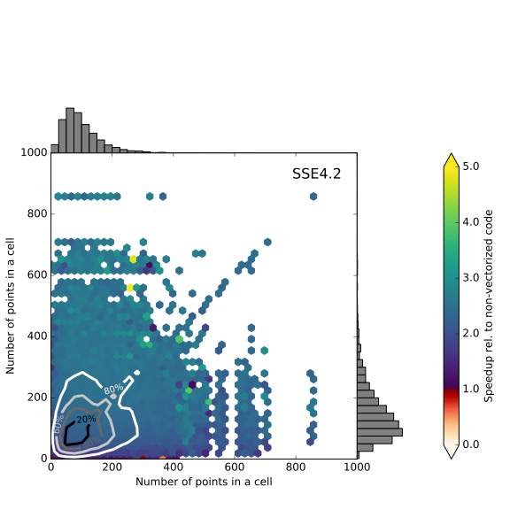
Speedup from Vectorization (SSE4.2)

Slide 40
for(int64_t i=0;i<N0;i++) {
const AVX512_FLOATS m_xpos = AVX512_SET_FLOAT(*x0++);
const AVX512_FLOATS m_ypos = AVX512_SET_FLOAT(*y0++);
const AVX512_FLOATS m_zpos = AVX512_SET_FLOAT(*z0++);
DOUBLE *localx1 = x1, *localy1 = y1, *localz1 = z1;
for(int64_t j=0;j<N1;j++) {
AVX512_MASK m_mask_left = (N1 - j) >= AVX512_NVEC ? ~0:masks_per_misalignment_value_DOUBLE[N1-j];
const AVX512_FLOATS m_x1 = AVX512_MASKZ_LOAD_FLOATS_UNALIGNED(m_mask_left, localx1);
const AVX512_FLOATS m_y1 = AVX512_MASKZ_LOAD_FLOATS_UNALIGNED(m_mask_left, localy1);
const AVX512_FLOATS m_z1 = AVX512_MASKZ_LOAD_FLOATS_UNALIGNED(m_mask_left, localz1);
/* this might actually exceed the allocated range but we will never dereference that */
localx1 += AVX512_NVEC;
localy1 += AVX512_NVEC;
localz1 += AVX512_NVEC;
const AVX512_FLOATS m_xdiff = AVX512_SUBTRACT_FLOATS(m_x1, m_xpos); /* (x[j:j+NVEC-1] - x0) */
const AVX512_FLOATS m_ydiff = AVX512_SUBTRACT_FLOATS(m_y1, m_ypos); /* (y[j:j+NVEC-1] - y0) */
const AVX512_FLOATS m_zdiff = AVX512_SUBTRACT_FLOATS(m_z1, m_zpos); /* z2[j:j+NVEC-1] - z1 */
const AVX512_FLOATS m_sqr_xdiff = AVX512_SQUARE_FLOAT(m_xdiff); /* (x0 - x[j])^2 */
const AVX512_FLOATS x2py2 = AVX512_FMA_ADD_FLOATS(m_ydiff, m_ydiff, m_sqr_xdiff);/* dy*dy + dx^2*/
const AVX512_FLOATS r2 = AVX512_FMA_ADD_FLOATS(m_zdiff, m_zdiff, x2py2);/* dz*dz + (dy^2 + dx^2)*/
const AVX512_MASK m_rpmax_mask = AVX512_MASK_COMPARE_FLOATS(m_mask_pimax, r2, m_sqr_rpmax, _CMP_LT_OQ);
/* Create a combined mask */
/* This gives us the mask for all sqr_rpmin <= r2 < sqr_rpmax */
m_mask_left = AVX512_MASK_COMPARE_FLOATS(m_rpmax_mask, r2, m_sqr_rpmin, _CMP_GE_OQ);
if(m_mask_left == 0) {
continue;
}
/* Loop backwards through nbins. m_mask_left contains all the points that */
/* are less than rpmax at the beginning of the loop. */
for(int kbin=nbin-1;kbin>=1;kbin--) {
const AVX512_MASK m_bin_mask = AVX512_MASK_COMPARE_FLOATS(m_mask_left, r2,m_rupp_sqr[kbin-1],_CMP_GE_OS);
npairs[kbin] += bits_set_in_avx512_mask_DOUBLE[m_bin_mask];
/* ANDNOT(X, Y) -> NOT X AND Y */
m_mask_left = AVX512_MASK_BITWISE_AND_NOT(m_bin_mask, m_mask_left);
if(m_mask_left == 0) {
break;
}
}
}
}

Slide 41
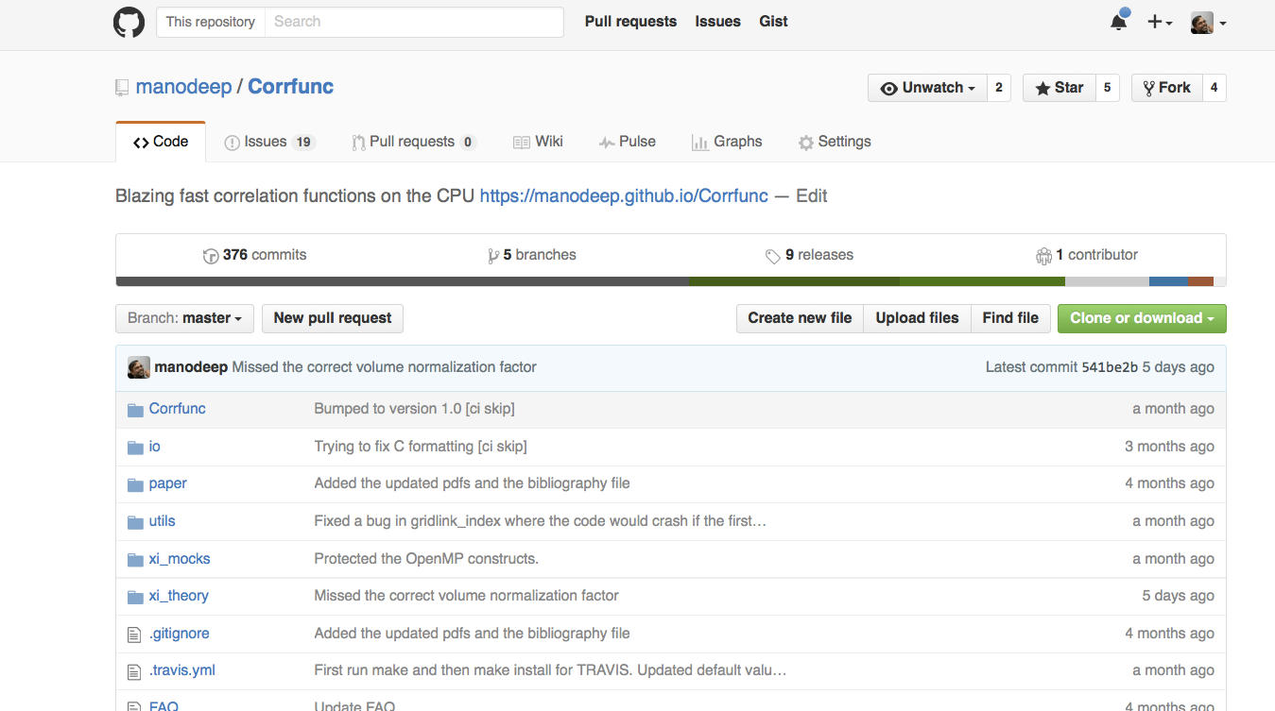
github.com/manodeep/Corrfunc/
Framework: PVD calculation reduced from 600+ hours to ~1 min

Slide 42
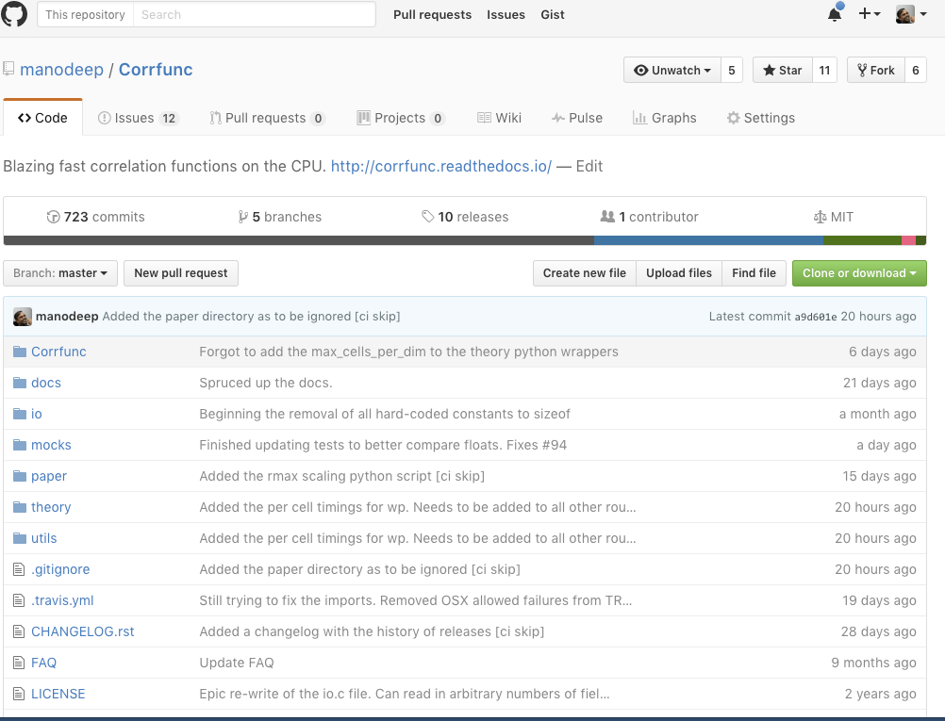
github.com/manodeep/Corrfunc/
Framework: PVD calculation reduced from 600+ hours to ~1 min
Framework: PVD calculation reduced from 600+ hours to ~1 min

Slide 43
github.com/manodeep/Corrfunc/
Framework: PVD calculation reduced from 600+ hours to ~1 min
Framework: PVD calculation reduced from 600+ hours to ~1 min

Slide 44
github.com/manodeep/Corrfunc/
Framework: PVD calculation reduced from 600+ hours to ~1 min
Framework: PVD calculation reduced from 600+ hours to ~1 min

Slide 45
Memory access is slow
Speed of light limitations (30 cm/ns)
For a 3 GHz clock, light only travels 10 cm
Many hardware layers between requesting memory and getting data
CPUs need to perform many calculations simultaneously

Slide 46
Bottlenecks in computing
https://blog.codinghorror.com/the-infinite-space-between-words/
How fast code runs depends on memory access patterns
How fast code runs depends on memory access patterns

Slide 47
How a CPU keeps busy (also why we got “Meltdown”)

Slide 48
CPU Performance Bottlenecks

Slide 49
Memory access is slow
https://blog.codinghorror.com/the-infinite-space-between-words/

Slide 50
Memory access is slow
https://blog.codinghorror.com/the-infinite-space-between-words/
How fast code runs depends on memory access patterns
How fast code runs depends on memory access patterns

Slide 51
Not all operations are equal
Modern cpus are extremely complex and try to predict data access patterns (hence, MELTDOWN, SPECTRE hardware bugs)
avoid if conditions (use `?’ for the ternary operator)
Divisions are 5 times more time-consuming than multiplication
Beware of trigonometric functions (use trig. identities, if possible)
Profile your code. I am wrong > 50% of the time

Slide 52
Users vs CPU vendor
User: Fastest time to solution is better
Vendor: Lowest power consumption for a fixed problem size while maintaining/improving time to solution
These two metrics are not the same

Slide 53
User wishlist vs CPU Features
User: Faster CPU clocks (write old-style code)
Physics is a buzzkill
Vendor: Slower and many more individual cores per cpu (think GPUs) with wider vector widths (more calculations per clock tick)

